Slide 1


Customer Reviews Classification
Submitted by:
Abdellah Ennajari
Abdellatif Chakor
Yassine Ben Acha
Here is where this template begins
Supervisor: Dr. Bentaleb Asmae
Jury:Dr. Alami Nabil
Academic Year: 2023/2024

Slide 2




Timeline
Training Classical Machine Learning Models
Conclusion
Introduction
Data Preparation and Preprocessing
Training and Evaluation for RoBERTa and XLNet

Slide 3
Data Preparation and Preprocessing

Slide 4
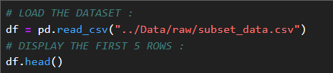
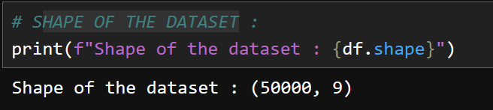
Data Preparation and Preprocessing :
The objective of this section is to perform essential data cleaning and preprocessing steps to prepare the customer review dataset for sentiment analysis.
Load the Dataset :
Dataset Overview :

Slide 5
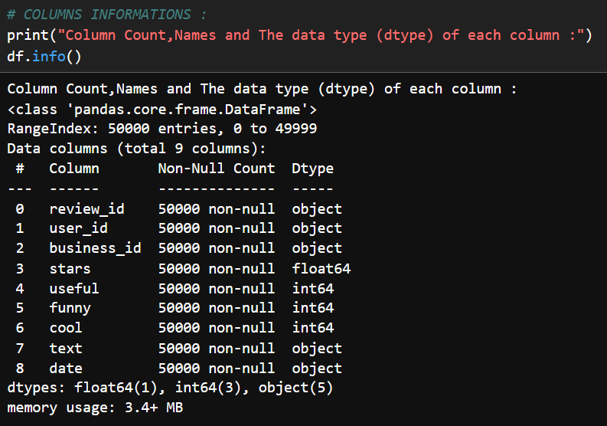
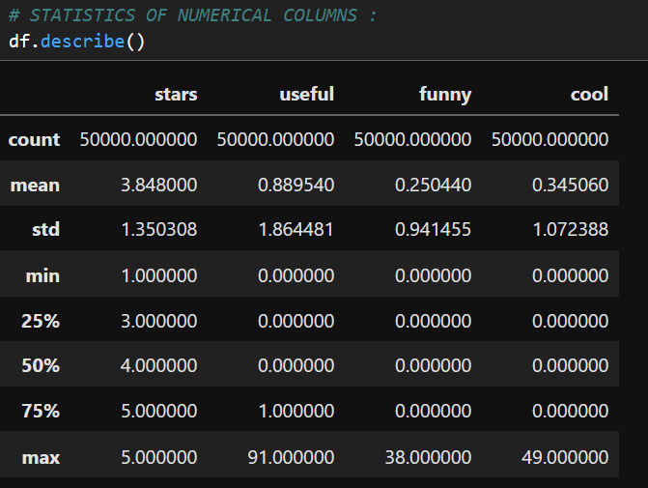
Data Preparation and Preprocessing :
Dataset Overview :

Slide 6
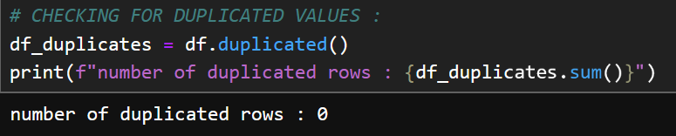
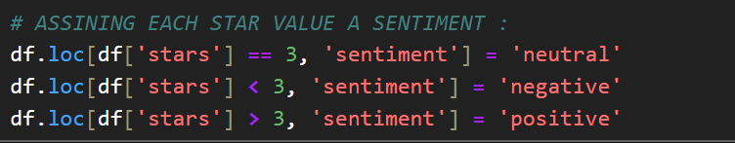
Handling Duplicated Values :
Target Variable Distribution :

Slide 7
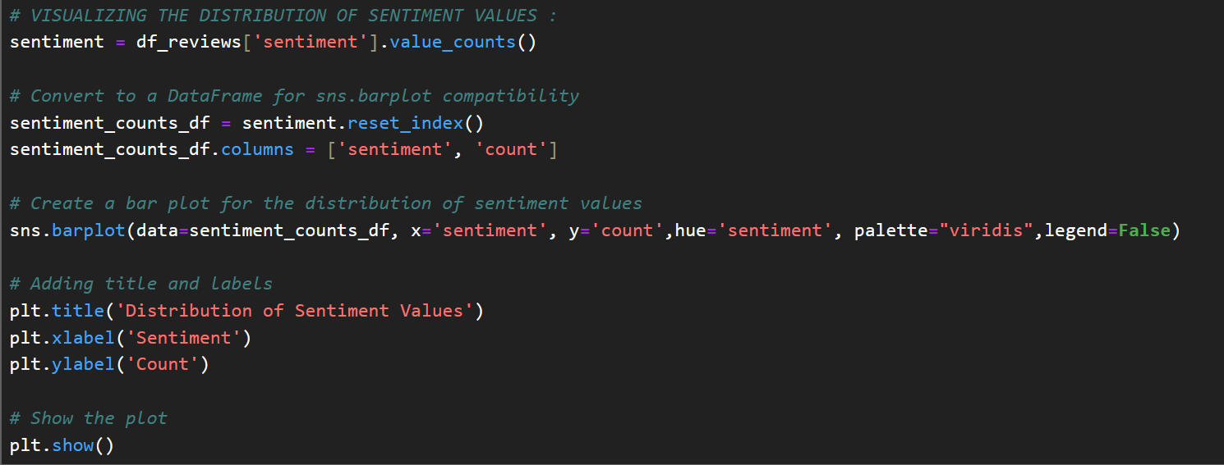
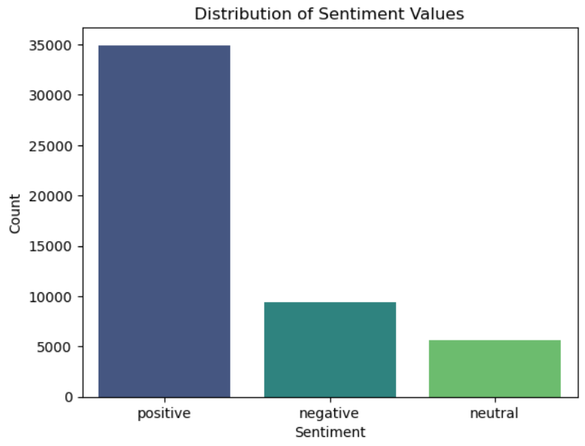
Visualizing the distribution of sentiment :
This distribution shows how customer opinions are spread across different sentiment categories, with positive reviews dominating, followed by negative reviews, and neutral reviews making up a smaller portion.

Slide 8

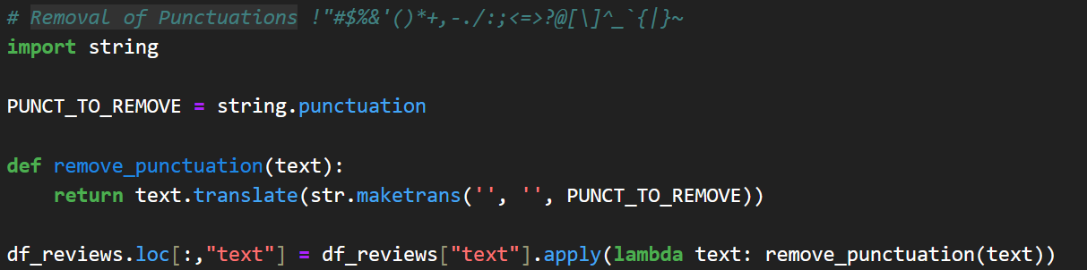
Text Preprocessing :
Before we start, we will create a new dataset with only the relevant columns for our analysis :
Convert Text to Lowercase :
Remove Punctuations from Text :

Slide 9
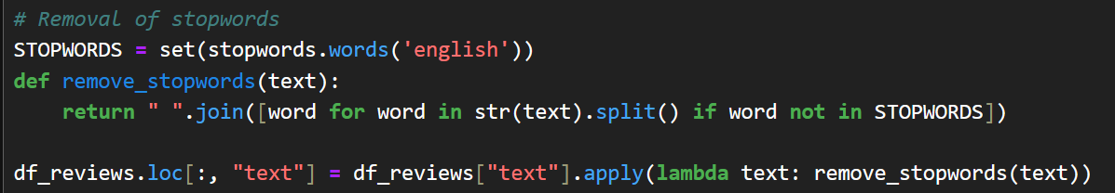
Remove Numbers from Text :
Handle newline and carriage return characters:
removing stopwords helps improve the quality of analysis by focusing on the words that hold the most meaning for understanding the text.such as "the", "is", "in", "and", "at" for english

Slide 10
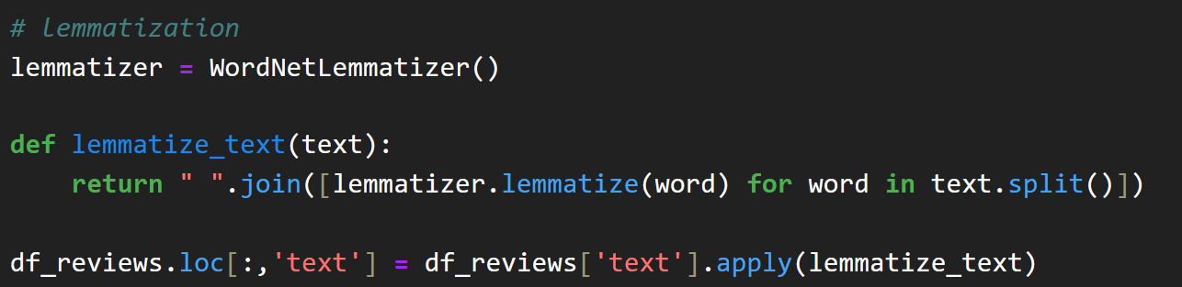
Text Lemmatization :
Lemmatization is a text preprocessing technique that reduces words to their base or root form (called a "lemma"), it also considers the word's meaning and context.
We also have stemming, which simply chops off prefixes or suffixes to reduce words.
lemmatization is generally preferred for tasks like sentiment analysis where the meaning of the word is important.
Text tokenization is the process of splitting a string of text into smaller units, typically words or phrases, called tokens.
Tokenization breaks down text into individual words, making it easier to analyze and understand the meaning of each word in a review

Slide 11
Text Lemmatization :
Lemmatization is a text preprocessing technique that reduces words to their base or root form (called a "lemma"), it also considers the word's meaning and context.
We also have stemming, which simply chops off prefixes or suffixes to reduce words.
lemmatization is generally preferred for tasks like sentiment analysis where the meaning of the word is important.
Text tokenization is the process of splitting a string of text into smaller units, typically words or phrases, called tokens.
Tokenization breaks down text into individual words, making it easier to analyze and understand the meaning of each word in a review

Slide 12
Relationship Between Sentiment and Length of Text :
The objective of analyzing the relationship between sentiment and text length is to understand whether the length of a review is related to its sentiment (positive, negative, or neutral).

Slide 13
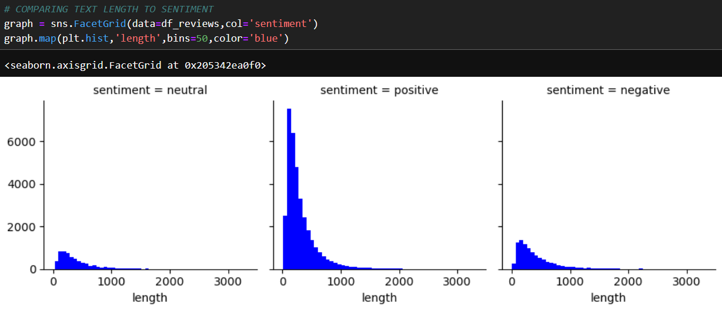
Relationship Between Sentiment and Length of Text :
After visualizing the plot :
we observe that positive reviews tend to have longer text lengths, indicating that customers may express their satisfaction in more detail.
Negative reviews show a moderate length, suggesting that dissatisfied customers provide sufficient information but not as extensively as positive reviewers.
Neutral reviews, on the other hand, tend to have shorter texts, possibly reflecting more neutral or less detailed feedback.

Slide 14
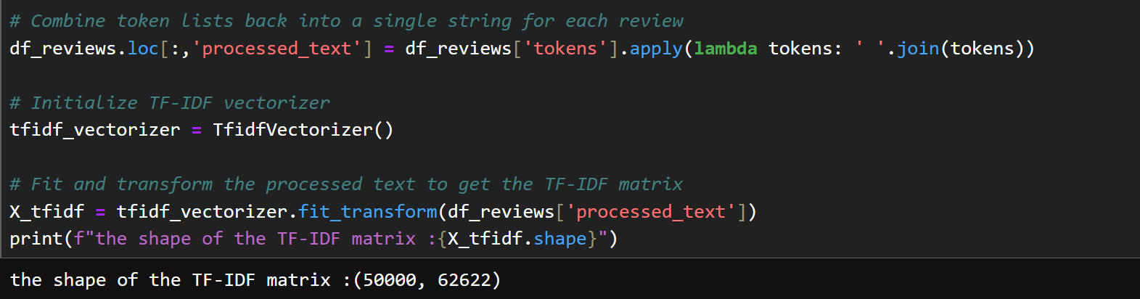
Feature Encoding :
We will use TF-IDF Vectorization (Term Frequency-Inverse Document Frequency) to convert text data into numerical features.
Why Choose TF-IDF?
. TF-IDF assigns higher weights to words that are important in a document.
. It transforms text data into a sparse numerical matrix, making it computationally efficient while retaining meaningful information.
. TF-IDF vectors integrate seamlessly with traditional machine learning algorithms.
How TF-IDF Works ?

Slide 15
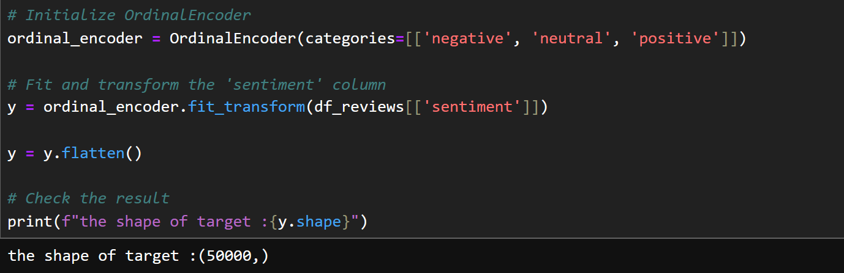
Feature Encoding :
For sentiment column we use OrdinalEncoder from sklearn.preprocessing with a predefined order for the sentiment categories (negative, neutral, positive.

Slide 16
Data Splitting :
ensuring the class distribution of the target variable is preserved (stratify=y) to handle its imbalance.

Slide 17
Training Classical Machine LearningModels

Slide 18
Before starting the next steps of our project, I will give a very brief introduction to our problem and its type.
The problem we are dealing with falls under supervised machine learning, specifically classification. This is because we are working on identifying categories—positive, negative, or neutral.
As part of our research, we explored various classification algorithms to determine which would be most suitable for our case. After thorough analysis, we identified six prominent algorithms: Logistic Regression, Decision Tree, Random Forest, Support Vector Machine (SVM), K-Nearest Neighbors (KNN), and Naive Bayes. These algorithms were chosen based on their efficiency, accuracy, and ability to handle the specific requirements of our classification task. After applying these models, we found that Logistic Regression and SVM provided the best accuracy and predictions, making them the most effective for our problem.

Slide 19
Machine Learning Infographics
Spam filtering
Mercury is the closest planet to the Sun
Some machine learning applications
Mobile banking
The Earth is the planet where we all live
Risk assessment
Despite being red, Mars is a cold place
Social networks
Jupiter is the biggest planet of them all

Slide 20
Machine Learning Infographics
01
02
Venus
Mercury
Venus has a beautiful name, but it’s hot
Mercury is the closest planet to the Sun

Slide 21
Machine Learning Infographics
01
02
Mercury
Venus
Mercury is the closest planet to the Sun
Machine learning
Venus has a beautiful name, but it’s hot
Yes, Saturn is a gas giant that has several rings
03
04
Earth
Mars
The Earth is the third planet from the Sun
Despite being red, Mars is a cold place

Slide 22
Machine Learning Infographics
Machine learning
Mars
04
Saturn is the gas giant that has rings
Despite being red, Mars is a cold place
Venus
03
Venus has a beautiful name, but it’s hot
Mercury
02
Mercury is the closest planet to the Sun
Earth
01
The Earth is the third planet from the Sun

Slide 23
Machine Learning Infographics
01
Power
AI
Memory
02
Mercury is the closest planet to the Sun
Neptune is the farthest planet from the Sun
System configuration
03
Memory
Mars
04
Jupiter is a gas giant and the biggest planet
Despite being red, Mars is a cold place
05
Security
FPGA
06
Venus has a beautiful name, but it’s hot
Pluto is considered a dwarf planet
07
MCU
Wireless
08
The Earth is the third planet from the Sun
Ceres is located in the main asteroid belt

Slide 24
Machine Learning Infographics
Artificial intelligence
Mercury is the closest planet to the Sun
Machine learning
Jupiter is a gas giant and the biggest planet
Deep learning
Venus has a beautiful name, but it’s hot

Slide 25
Machine Learning Infographics
Output unit
Neural network
Yes, Saturn is a gas giant that has rings
01
Output layer
02
Input layer
Input unit 1
Input unit 2

Slide 26
Machine Learning Infographics
01
02
03
04
1950s
1960s
1970s
1980s
Simple algorithms
Bayesian methods
AI winter caused by pessimism
Resurgence in ML research
Mercury is the closest planet to the Sun
Jupiter is a gas giant and the biggest planet
Venus has a beautiful name, but it’s very hot
Mercury is the closest planet to the Sun
05
06
07
1990s
2000s
2010s
Data-driven approach
Support-Vector Clustering
Deep learning popularity
The Earth is the third planet from the Sun
Ceres is located in the main asteroid belt
Venus has a beautiful name, but it’s very hot

Slide 27
Machine Learning Infographics
Continuous improvement
Machine learning disadvantages
01
Despite being red, Mars is a cold place
Data acquisition
02
Venus has a beautiful name, but it’s hot
Patterns identification
03
Mercury is the closest planet to the Sun
Time and resources
04
The Earth is the third planet from the Sun

Slide 28
Machine Learning Infographics
01
02
Image recognition
Customization
The Earth is the planet where we live
Despite being red, Mars is a cold place
03
04
Voice recognition
Opportunities of machine learning
Data analysis
Venus has a beautiful name, but it’s hot
The Earth is the third planet from the Sun
05
06
Optical recognition
Memory data
Mercury is the closest planet to the Sun
Pluto is considered a dwarf planet

Slide 29
Machine Learning Infographics
Machine learning
The model
Venus has a beautiful name, but it’s hot
Despite being red, Mars is a cold place
Input 1
Input 2
The Earth is the third planet from the Sun
Mercury is the closest planet to the Sun

Slide 30
Machine Learning Infographics
01 | Supervised learning
 | Venus has a beautiful name, but it’s hot
02 | Unsupervised learning
 | Despite being red, Mars is a cold place
03 | Semi-supervised learning
 | The Earth is the third planet from the Sun
04 | Reinforcement learning
 | Mercury is the closest planet to the Sun
05 | Dimensionality reduction
 | Pluto is considered a dwarf planet

Slide 31
Machine Learning Infographics
01
Active learning
Maturation
02
Mercury is the closest planet to the Sun
Jupiter is a gas giant and the biggest planet
03
Motor synergies
Imitation
04
The Earth is the planet where we live
Despite being red, Mars is a cold place

Slide 32
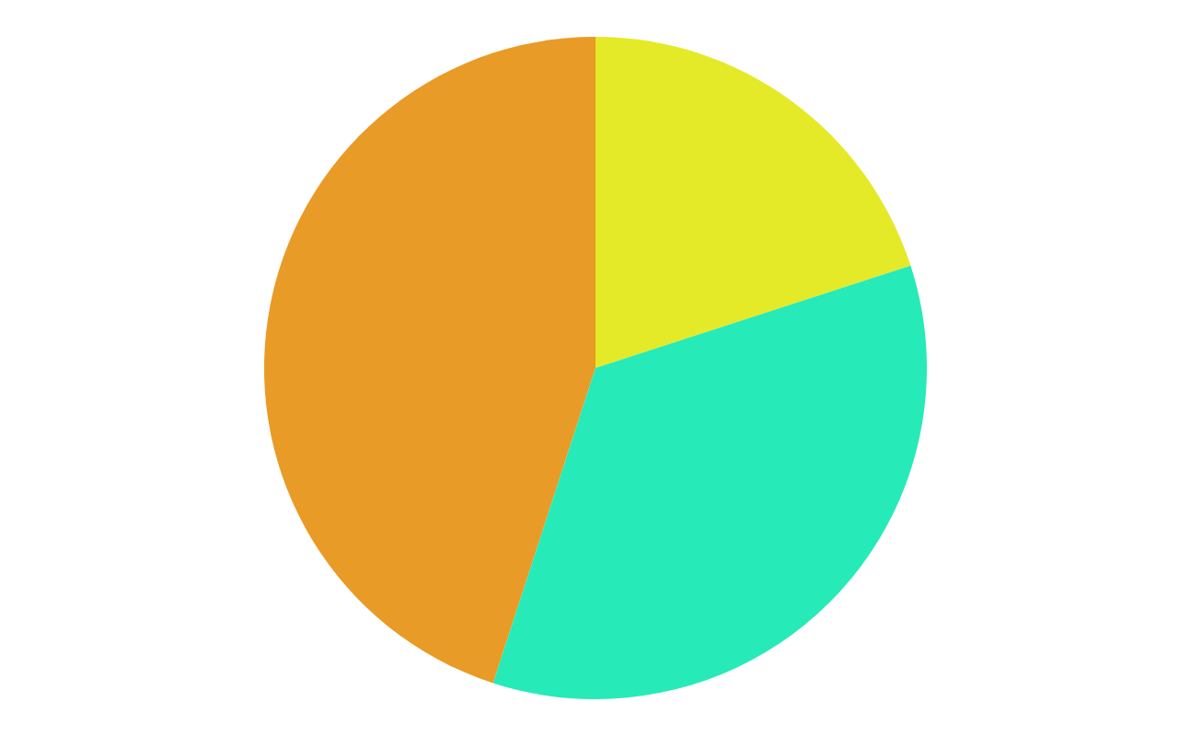
Machine Learning Infographics
45%
20%
Data mining
Intrusion detection
The Earth is the third planet from the Sun
Mercury is the closest planet to the Sun
35%
Continuous production
Despite being red, Mars is a very cold place
Follow the link in the graph to modify its data and then paste the new one here. For more info, click here

Slide 33
Machine Learning Infographics
01
Classify data
Mercury is the closest planet to the Sun
Machine learning objectives
02
Make predictions
The Earth is the planet where we live

Slide 34
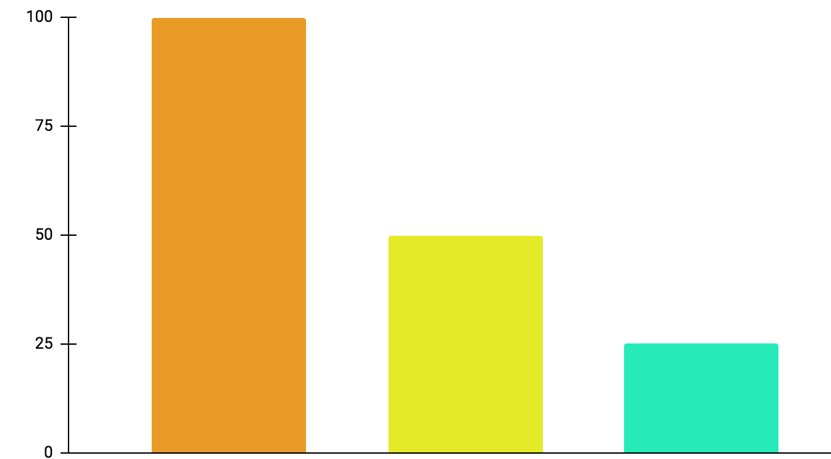
Machine Learning Infographics
01
Active learning
Mercury is the closest planet to the Sun
02
Maturation
Jupiter is a gas giant and the biggest planet
03
Motor synergies
Neptune is very far away from the Sun
100%
50%
25%
Follow the link in the graph to modify its data and then paste the new one here. For more info, click here

Slide 35
Machine Learning Infographics
Models
Artificial neural networks | The Earth is the planet we live on
Decision trees | Mercury is the smallest planet
Support-vector machines | Despite being red, Mars is a cold place
Regression analysis | Jupiter is the biggest planet of them all
Bayesian networks | Venus has a beautiful name
Genetic algorithms | Pluto is considered a dwarf planet

Slide 36
Machine Learning Infographics
Collect the data
Prepare the data
Mercury is the closest planet to the Sun
The Earth is the third planet from the Sun
Train a model
Despite being red, Mars is a cold place
Improve
Evaluate the model
Pluto is considered a dwarf planet
Jupiter is the biggest planet of them all

Slide 37
Machine Learning Infographics
Inputs
Outputs
Mercury is the closest planet to the Sun
Jupiter is a gas giant and the biggest planet
Input 1
Output 1
Input 2
Output 2
Input 3
Output 3

Slide 38
Machine Learning Infographics
Supervised learning
Unsupervised learning
Reinforcement learning
Classification
Reduction
Fraud detection
Email spam detection
Diagnostics
Image classification
Text mining
Data visualization
Face detection
Voice detection
Finances
Manufacturing
Stock management
Autonomous cars
Regression
Regression
Risk assessment
Score prediction
City planning
Targeted marketing

Slide 39
Machine Learning Infographics
Predict trends
01
02
Innovation
Venus has a beautiful name, but it’s hot
Despite being red, Mars is a cold place
Target segmentation
03
Cost reduction
04
Mercury is the closest planet to the Sun
Neptune is very far away from the Sun
Advert segmentation
05
06
Customer relations
ML for business
The Earth is the third planet from the Sun
Jupiter is the biggest planet of them all

Slide 40
Machine Learning Infographics
Machine learning application example
Polite
Offensive
01
02
03
04
Tweet
Feature engineering
Classification
Output
Mercury is the closest planet to the Sun
Venus has a beautiful name, but it’s hot
The Earth is the third planet from the Sun
Despite being red, Mars is a cold place

Slide 41
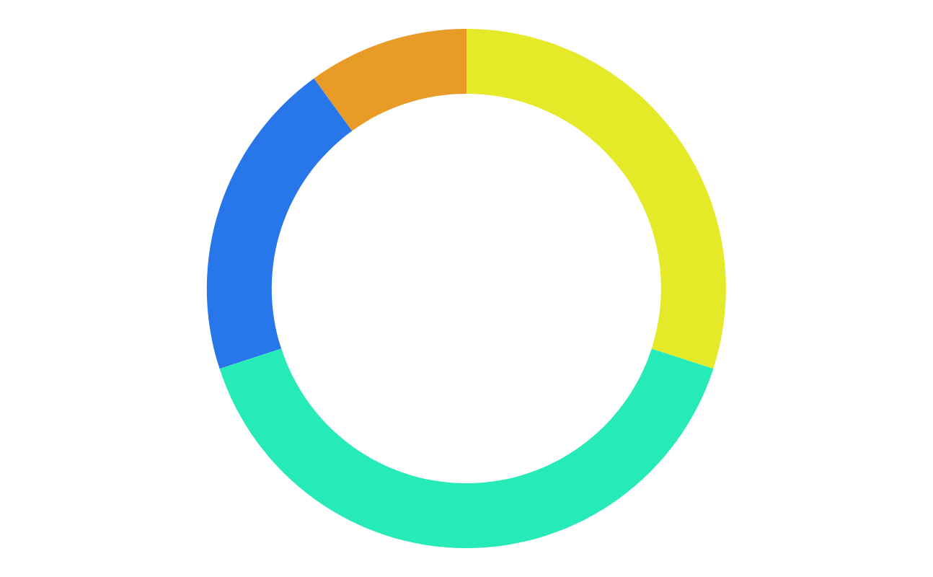
Machine Learning Infographics
10%
30%
Mercury
Jupiter
Mercury is the closest planet to the Sun
Jupiter is a gas giant and the biggest planet
20%
40%
Neptune
Mars
It’s the farthest planet from the Sun
Despite being red, Mars is a cold place
Follow the link in the graph to modify its data and then paste the new one here. For more info, click here

Slide 42
Machine Learning Infographics
Biochemical analysis
Disease diagnosis
Drug discovery
Mercury is the closest planet to the Sun
Venus has a beautiful name, but it’s hot
The Earth is the third planet from the Sun

Slide 43
Machine Learning Infographics
 | Common Uses for Machine Learning
01 | Chatbot systems | Venus has a beautiful name, but it’s hot
02 | Decision support | Mercury is the closest planet to the Sun
03 | Customer recommendation engines | The Earth is the third planet from the Sun
04 | Customer churn modeling | Despite being red, Mars is a cold place
05 | Pricing strategies | Neptune is the farthest planet from the Sun
06 | Customer segmentation | Jupiter is the biggest planet of them all
07 | Image classification | Pluto is now considered a dwarf planet

Slide 44
Machine Learning Infographics
Input data
Neptune
Mars
It’s the farthest planet from the Sun
Despite being red, Mars is a cold place
Learning system
Mercury is the closest planet to the Sun
Output data

Slide 45
Machine Learning Infographics
Machine learning advantages vs disadvantages
Advantages
Disadvantages
Efficiency data managing
Continuous improvement
Lots of applications
Trend identification
Pattern identification
Data acquisition
Time and space
Time-consuming
High error possibilities
Algorithm selection

Slide 46
Machine Learning Infographics
01
02
03
Identify data
Choose algorithm
Analytical model
Venus has a beautiful name, but it’s hot
Mercury is the closest planet to the Sun
Despite being red, Mars is a cold place
04
05
Train the model
Run the model
Jupiter is the biggest planet of them all
Neptune is very far away from the Sun

Slide 47
Machine Learning Infographics
Input data
Jupiter is the biggest planet of them all
Relationships
Patterns
Machine learning
Algorithms + techniques
Dependencies
Structures
Output
Despite being red, Mars is a cold place

Slide 48
Instructions for use
In order to use this template, you must credit Slidesgo in your final presentation.
You are allowed to:
- Modify this template.
- Use it for both personal and commercial projects.
You are not allowed to:
- Sublicense, sell or rent any of Slidesgo Content (or a modified version of Slidesgo Content).
- Distribute Slidesgo Content unless it has been expressly authorized by Slidesgo.
- Include Slidesgo Content in an online or offline database or file.
- Offer Slidesgo templates (or modified versions of Slidesgo templates) for download.
- Acquire the copyright of Slidesgo Content.
For more information about editing slides, please read our FAQs or visit Slidesgo School:
https://slidesgo.com/faqs and https://slidesgo.com/slidesgo-school

Slide 49
Instructions for use (premium users)
In order to use this template, you must be a Premium user on Slidesgo.
You are allowed to:
Modify this template.
Use it for both personal and commercial purposes.
Hide or delete the “Thanks” slide and the mention to Slidesgo in the credits.
Share this template in an editable format with people who are not part of your team.
You are not allowed to:
Sublicense, sell or rent this Slidesgo Template (or a modified version of this Slidesgo Template).
Distribute this Slidesgo Template (or a modified version of this Slidesgo Template) or include it in a database or in any other product or service that offers downloadable images, icons or presentations that may be subject to distribution or resale.
Use any of the elements that are part of this Slidesgo Template in an isolated and separated way from this Template.
Register any of the elements that are part of this template as a trademark or logo, or register it as a work in an intellectual property registry or similar.
For more information about editing slides, please read our FAQs or visit Slidesgo School:
https://slidesgo.com/faqs and https://slidesgo.com/slidesgo-school

Slide 50
Infographics
You can add and edit some infographics to your presentation to present your data in a visual way.
Choose your favourite infographic and insert it in your presentation using Ctrl C + Ctrl V or Cmd C + Cmd V in Mac.
Select one of the parts and ungroup it by right-clicking and choosing “Ungroup”.
Change the color by clicking on the paint bucket.
Then resize the element by clicking and dragging one of the square-shaped points of its bounding box (the cursor should look like a double-headed arrow). Remember to hold Shift while dragging to keep the proportions.
Group the elements again by selecting them, right-clicking and choosing “Group”.
Repeat the steps above with the other parts and when you’re done editing, copy the end result and paste it into your presentation.
Remember to choose the “Keep source formatting” option so that it keeps the design. For more info, please visit Slidesgo School.

